Slide 2
1-5 scale
Early summer: late April – June
Most useful to score when variability is highest
Notes:
More about hair shedding scores as an indicator trait, data sharing scheme

Slide 3
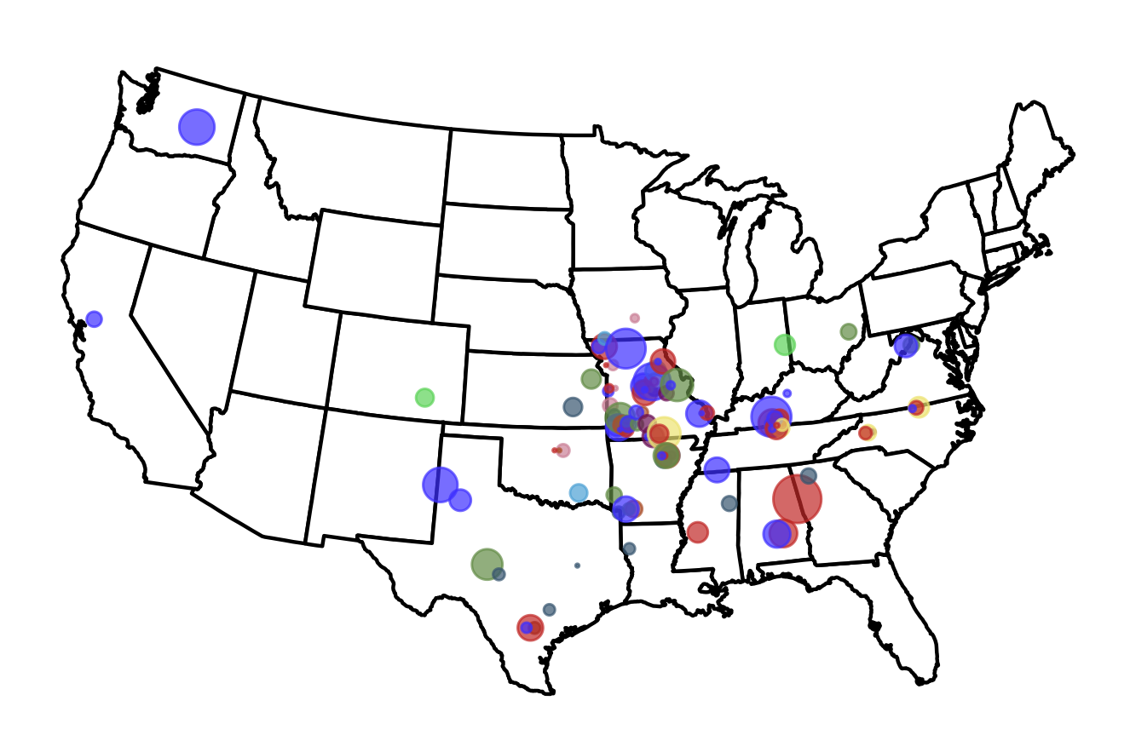
Notes:
Even within the same breed, the qualities that you look for in replacements are not completely the same across environments. Colorado Alabama
This project is part of a larger effort to identify cattle that are well adapted to their environment
Stressors that is relevant to this part of the world heat fescue
Way we’re identifying that thru scoring
About the project
~12,000 16-17 hair scores

Slide 4
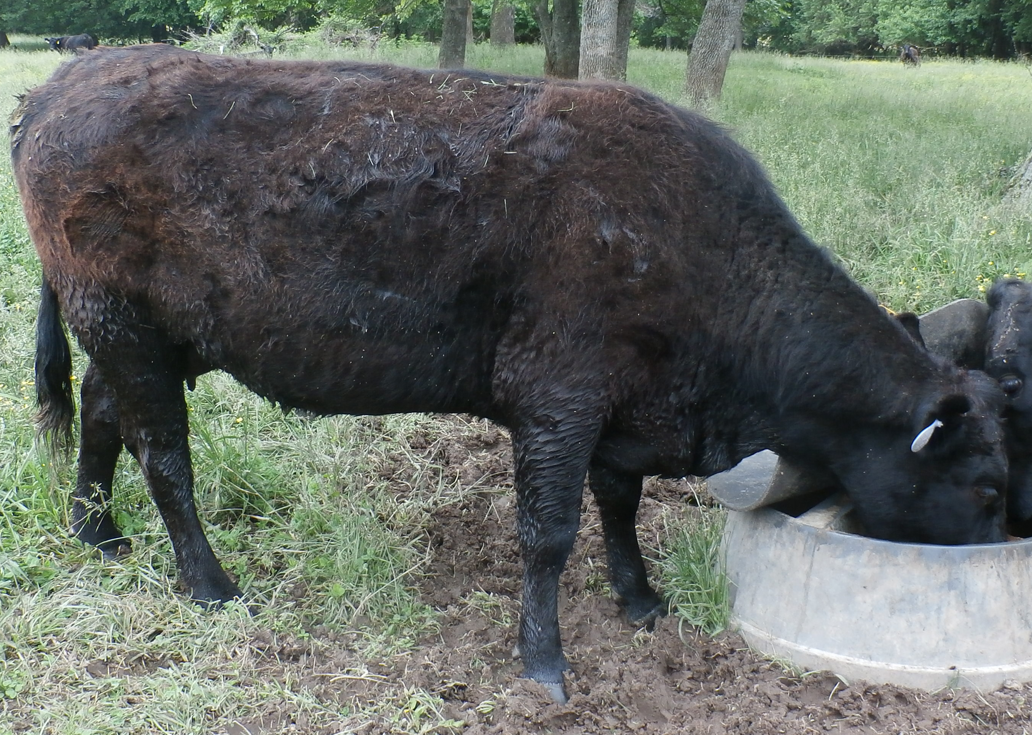
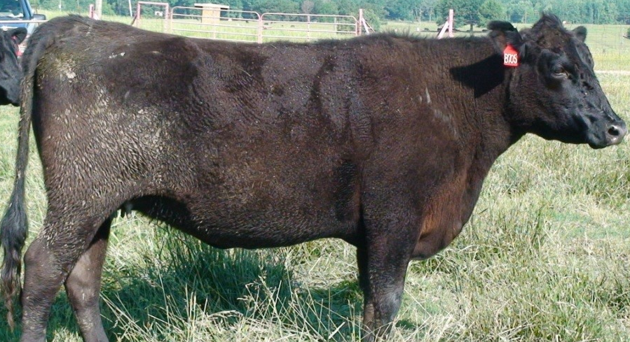
Score 5
0% shed off
(full winter coat)
Eldon Cole (MU Extension)
Trent Smith (Mississippi State)
Notes:
Go thru briefly

Slide 5
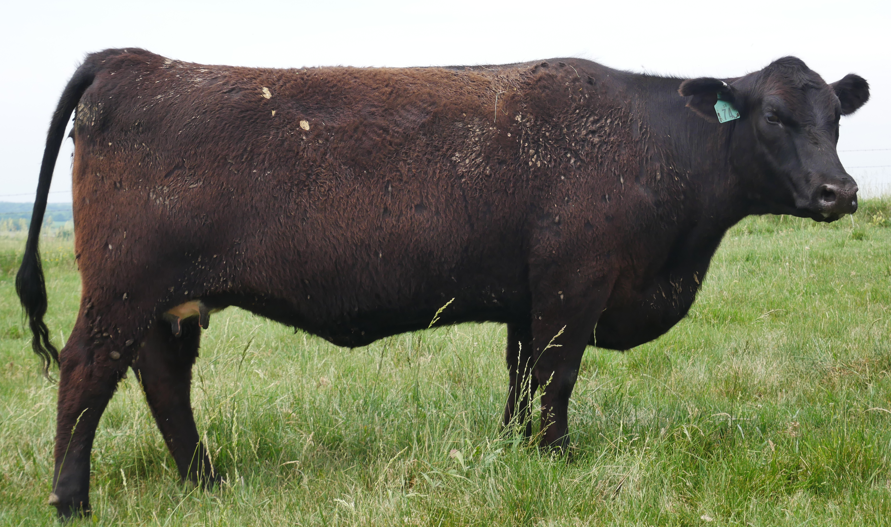
Score 4
25% shed off

Slide 6
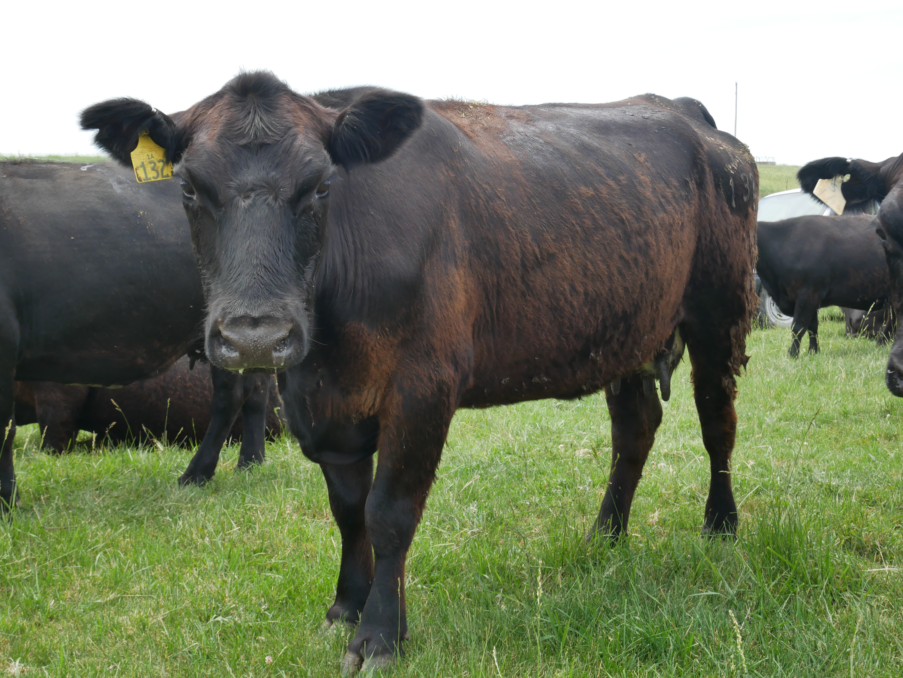
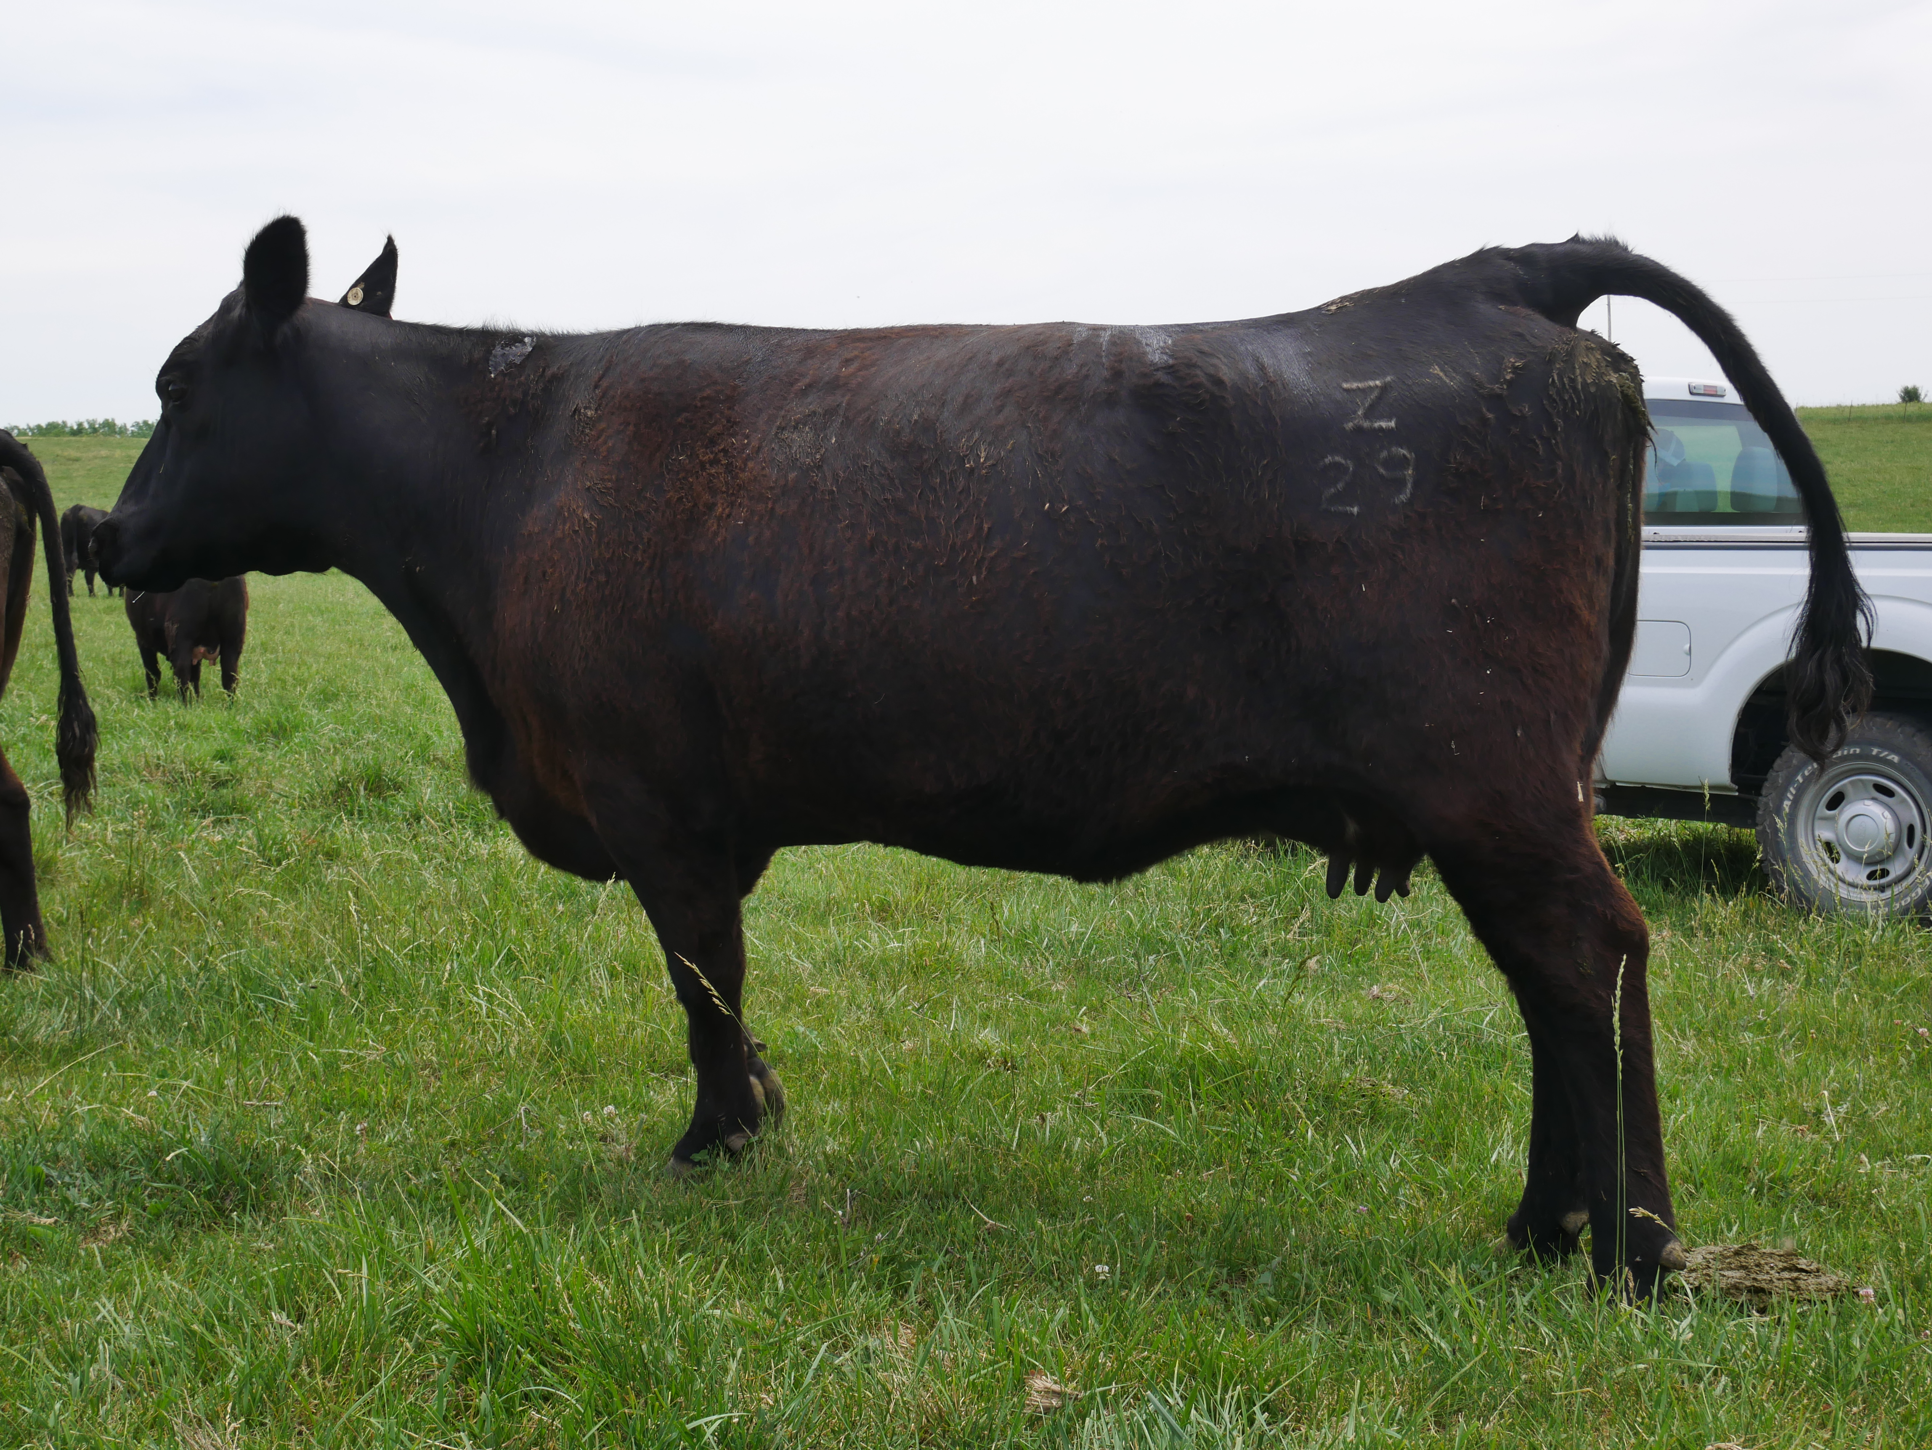
Score 3
50% shed off

Slide 7
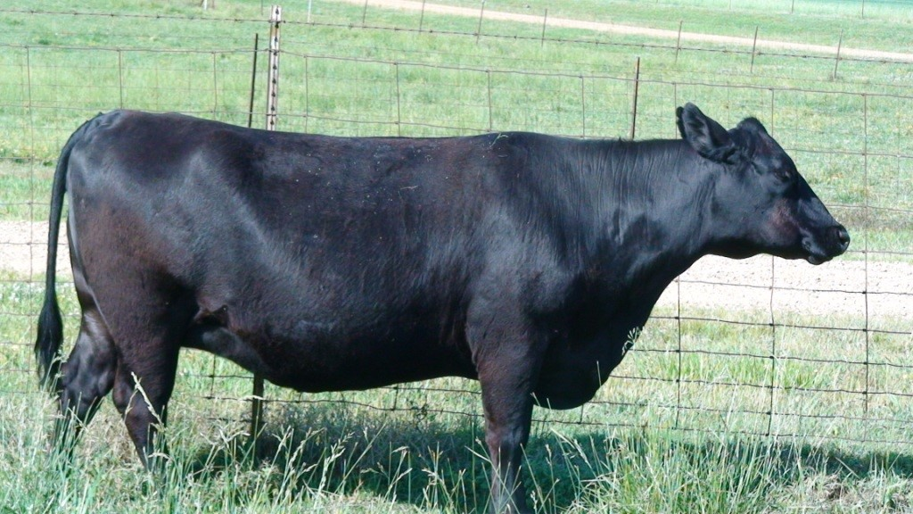
Score 2
75% shed off

Slide 8
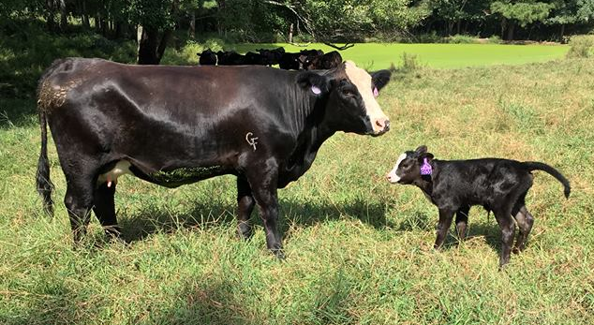
Score 1
100% shed off (no winter coat)

Slide 9
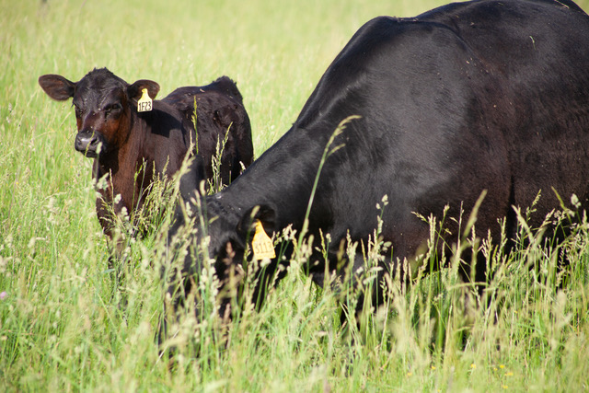
Weaning weight
After adjusting for:
Sex of calf
Farm effect
Calving season
We find:
~10.70 lb. difference on average between hair shedding score in Red Angus Association of America data
~12.00 lb. difference on average between hair shedding score in American Simmental Association data

Slide 10
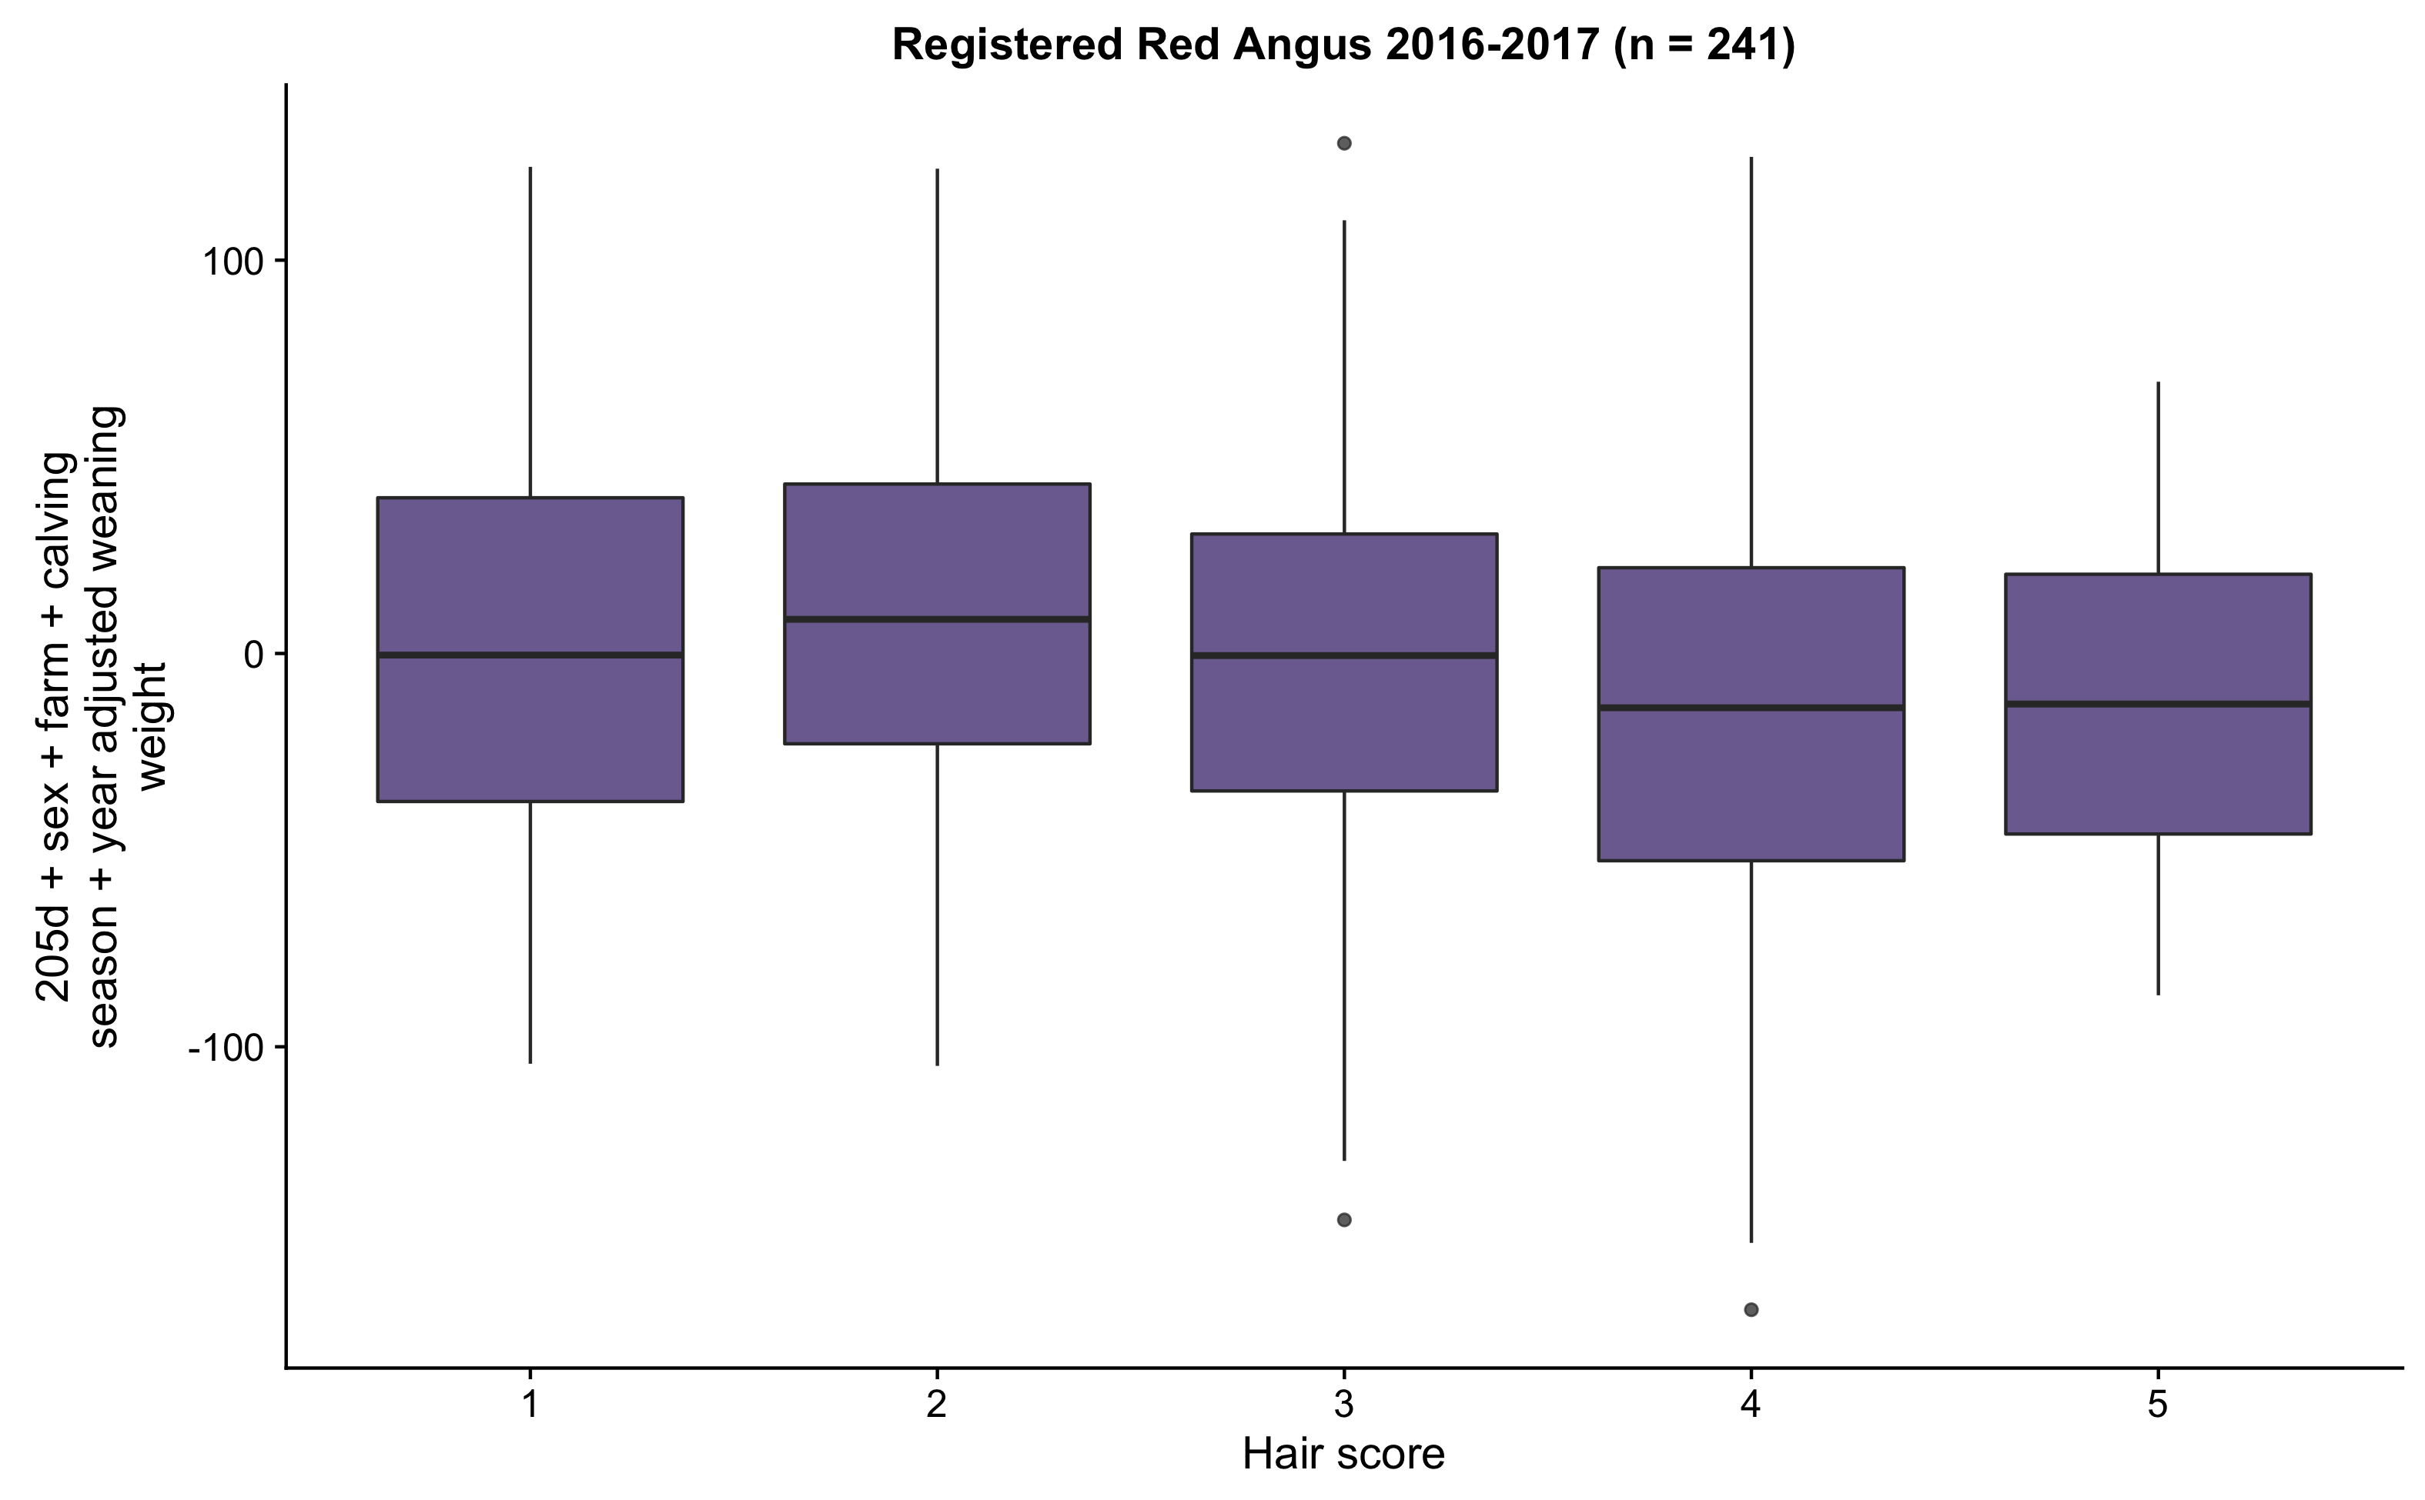

Slide 11
Weaning weight
After adjusting for:
Sex of calf
Farm effect
Calving season
We find:
~10.70 lb. difference on average between hair shedding score in Red Angus Association of America data
~12.00 lb. difference on average between hair shedding score in American Simmental Association data

Slide 12
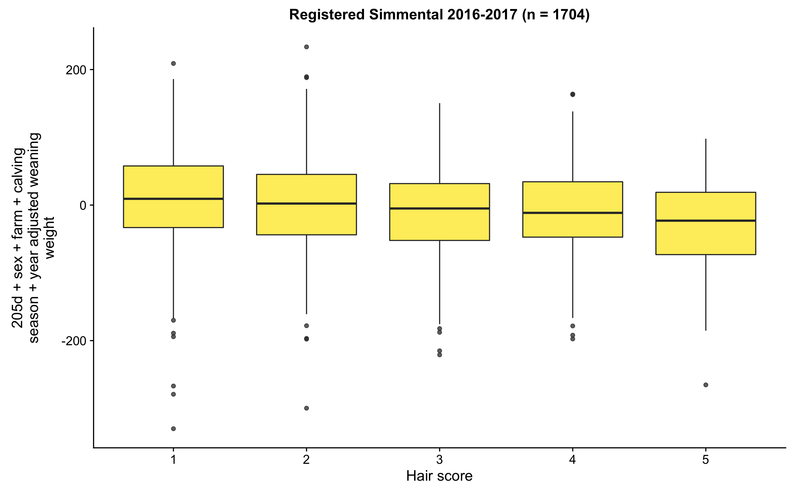

Slide 13
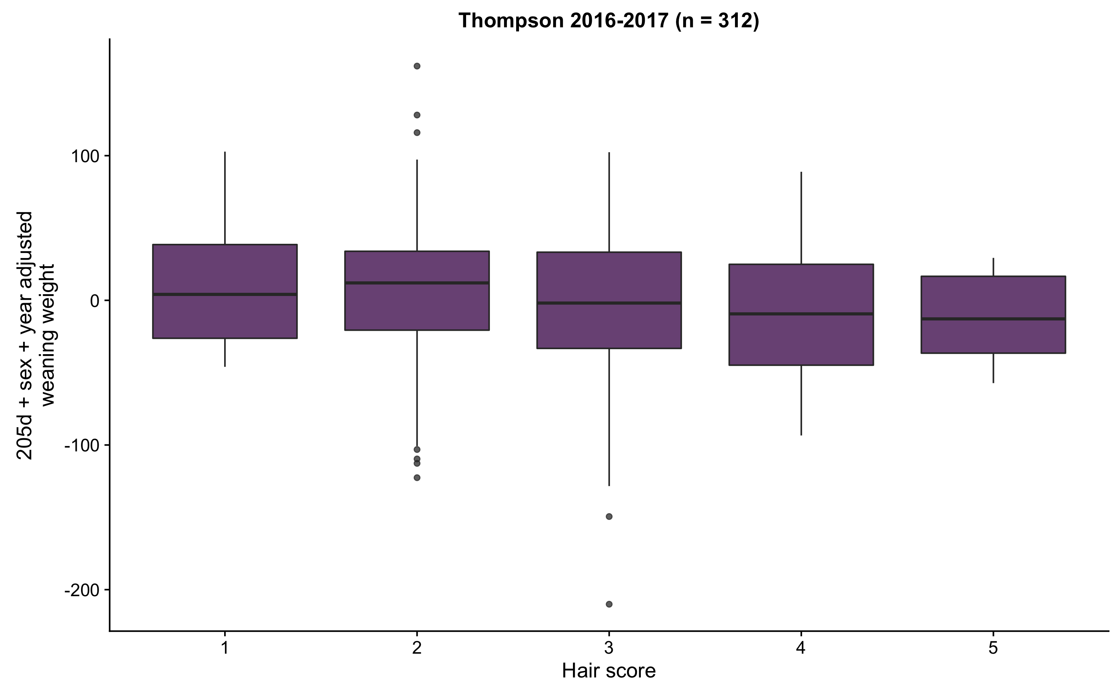

Slide 14
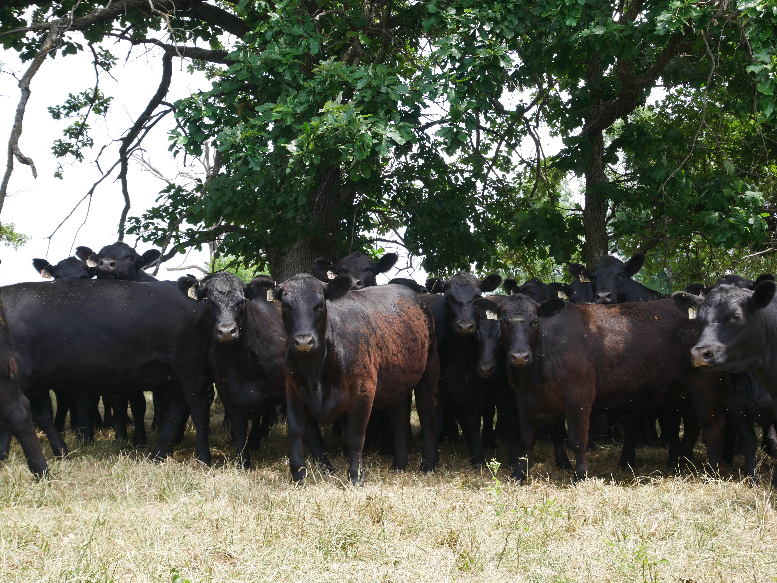
Heritability
0.38 – 0.45 heritability
~40% of variation in hair shedding is due to genetics

Slide 15
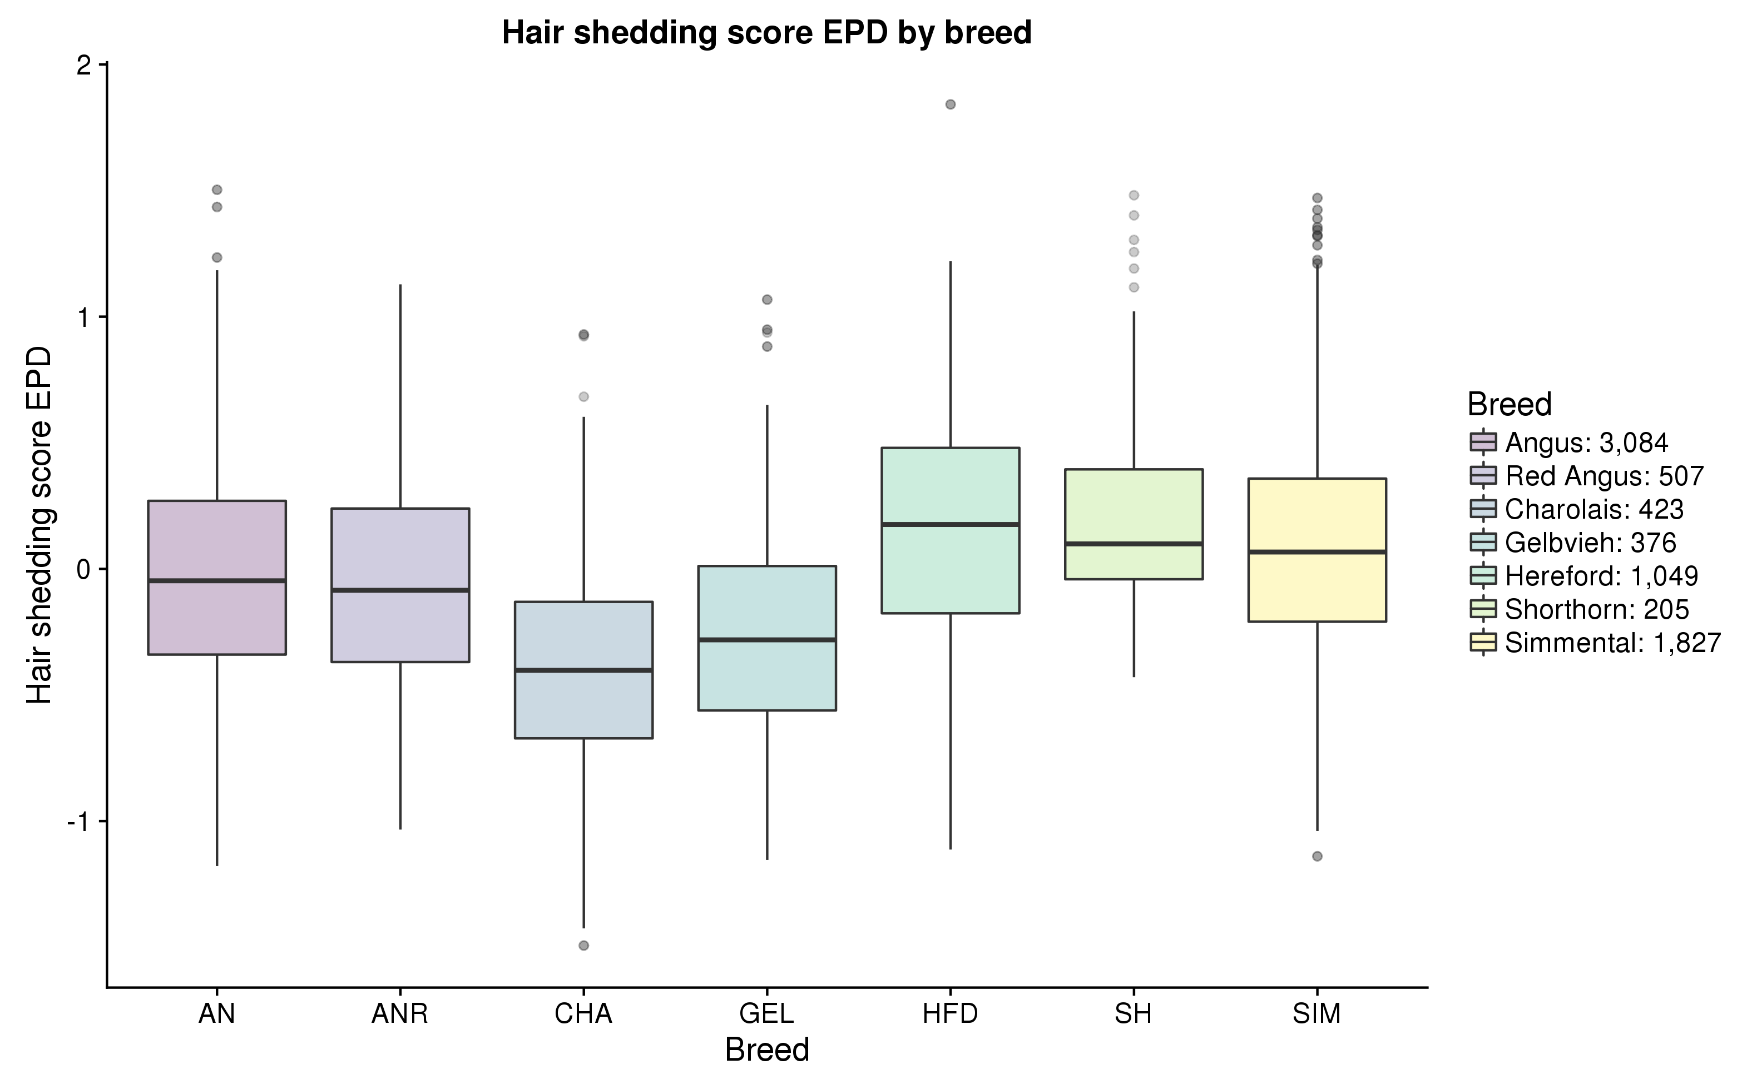

Slide 16
Thanks to participating producers!
Dr. Jared Decker
deckerje@missouri.edu
Harly Durbin
hjdurbin@mail.missouri.edu

